Slide 1
Precision Measurement of the Radiative Decay Mode of the Neutron
RDK II Collaboration
June 22, 2010 Pizza Lunch
Arizona State University
R. Alarcon, B. O’Neill
University of Maryland
E. Beise, H. Breuer
University of Michigan
M. Bales, T. Chupp, R. Cooper
National Institute of Science & Technology (NIST)
C. Bass, K. Coakley, S. Dewey, C. Fu, T. Gentile, P. Mumm, J. Nico, A. Thompson
University of Sussex
J. Byrne
Tulane University
F. Wietfeldt, K. Pulliam
Notes:
Good afternoon, my name is Ben O’Neill. I am here today on behalf of the RDK II collaboration to discuss some of the techniques and results of the second experiment at the National Institute of Standards &Technology to measure the radiative decay mode of the neutron.

Slide 2
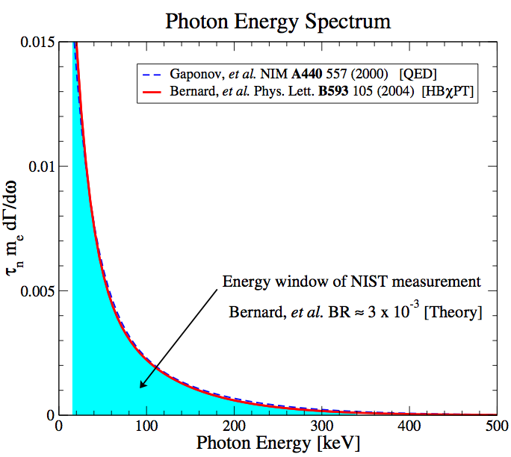
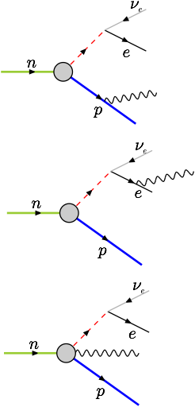
Theory
RDK I branching ratio¹
3.09 ± 0.32 x 10⁻³
¹Nico, J. S. et al. Nature 444, 1059–1062 (2006)
Notes:
Quantum electro dynamics predicts that a spectrum of low energy photons will be emitted from the decay of free neutrons. This interaction is dominated by the production of Bremsstrahlung radiation from the electron , shown in the middle tree diagram. /*This is an intrinsic property of the neutron decay and can be thought of, classically, as an electron created in the rest frame and accelerated to its final velocity.*/ As you can see from the small differences in the red and dashed lines on this chart, higher order corrections , shown in the bottom tree diagram, do not contribute significantly to the branching ratio and spectrum. In 2006, we reported measuring the branching ratio in agreement with theory and 10% uncertainty. With this latest experiment, we anticipate reducing that uncertainty to approximately 1%.

Slide 3
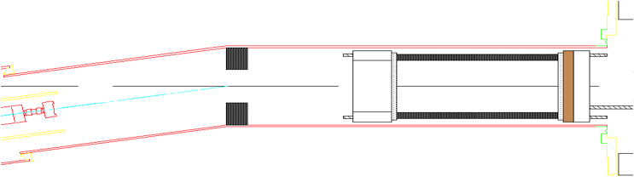

Overview
12-element annular
BGO/APD array
neutrons
Pb shield
bAPD array
(not shown)
electrostatic mirror (not shown)
silicon detector
National Institute of Standards & Technology (NIST) NG6 cold neutron beam
On beam from July 2008 to Nov 2009
4.6 T magnetic field traps charged decay products to tight orbits giving large solid angle coverage
Electrostatic mirror turns around “wrong-way” protons
Delayed electron-proton coincidence trigger
Waveform-based data acquisition
Notes:
Like its predecessor, RDK II was situated on the NG6 cold neutron beam at NIST, about 20 miles north west of here. The experiment ran for approximately 16 months. As you can see from this diagram, neutrons enter from the left hand side of the slide. The resulting electrons and protons from those neutrons that decay are captured by a strong magnetic field and guided into the silicon detector here. By triggering on a delayed electron-proton coincidence we can eliminate most uncorrelated events since, as Matt will show in the next talk, most neutrons decaying along the beam will result in the capture of both an electron and proton. The photon detectors, marked in red, are the biggest improvements over RDK I, which had only a single detector element.

Slide 4
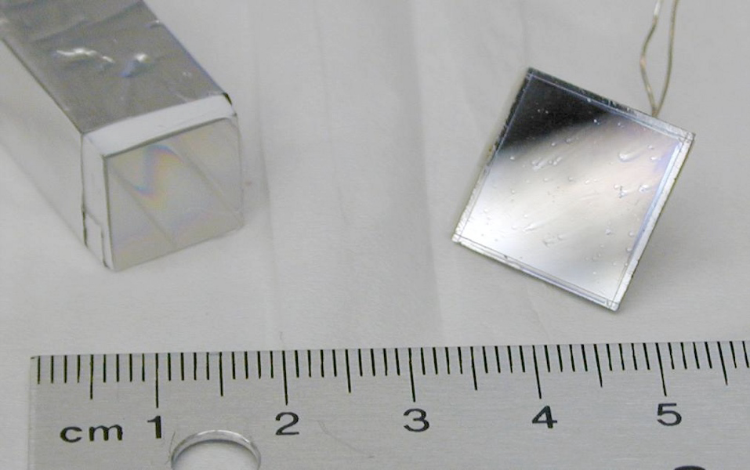
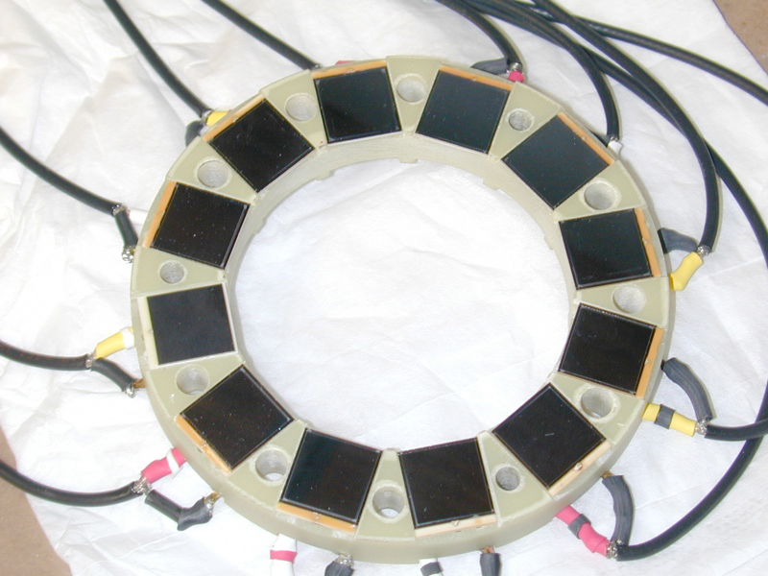
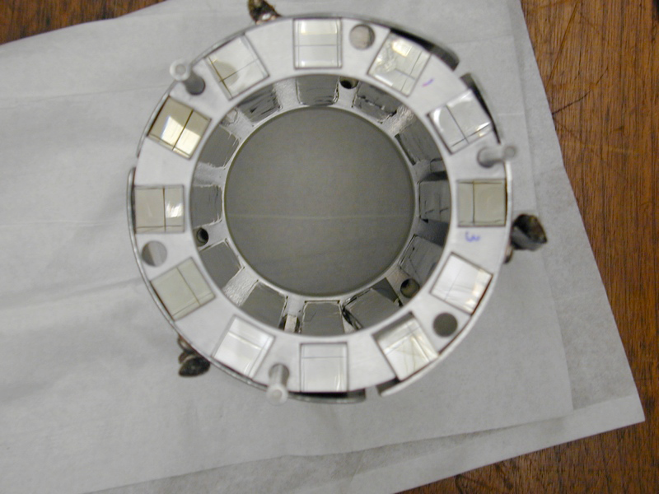
Primary detector
Bismuth germanate (BGO) scintillator crystals coupled to avalanche photo-diodes (APD)
12 detectors
200x12x12mm³ BGOs
14x14mm² APDs
<10keV-endpoint
Notes:
The primary detector in our experiment is an array of 12 bismuth germante scintillator crystals attached to avalanche photo-diodes. Although we haven’t performed detailed calibrations, we anticipate having a usable energy range from under 10keV to the endpoint. We chose to use BGOs and APDs for several reasons, primarily because of the extreme operating conditions they would need to endure.

Slide 5
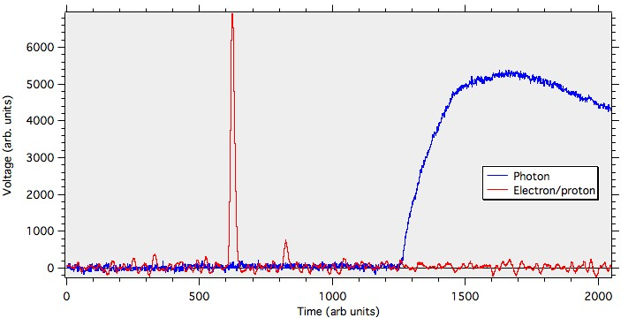
Primary detector
APDs operate in vacuum and high magnetic field (~5 T)
APD gain increases and noise decreases with cooling
Light yield of BGO increases with cooling
Large crystals available at reasonable cost
Stable operation over weeks of operation
Notes:
We required equipment that would operate in a vacuum, high magnetic fields, and at liquid nitrogen temperatures. As an added bonus, the cryogenic temperatures improve the operation of the BGO/APD combination.
Here is a common event with the signal from the BGO/APD detectors. The red line is the electron and proton signal, while the blue line is a photon signal. The large red peak is an electron, while the smaller peak is a proton. Since the photon signal is significantly delayed, this particular event is not a radiative decay event.

Slide 6
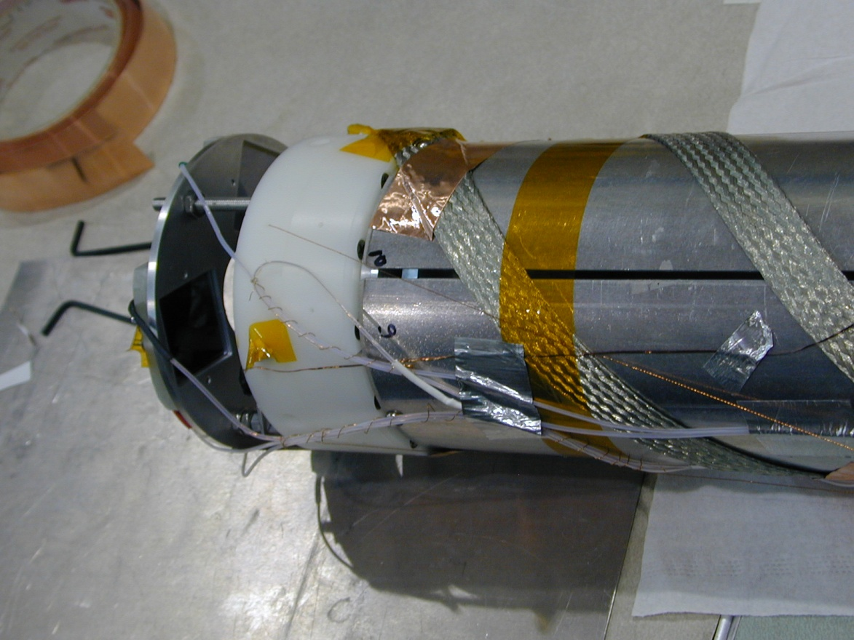
Direct detector
Large area bare avalanche photo-diode (bAPD)
3 detectors
28x28mm²
~500eV-20keV
Notes:
Towards the end of the run, an additional detector package was added. These large area bare APDs were added to increase the detectable energy range down to below 1keV.

Slide 7
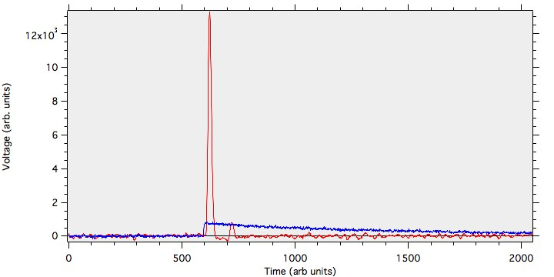
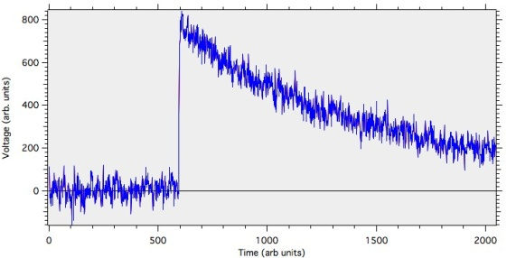
Direct detector
Lower energy range
Lower background
Narrower timing peak
Smaller cross section
Notes:
Besides the lower energy range, there were a few benefits to using bare APDs. For one, there was almost no background, until we installed a calibration source. Also, since the photon energy is deposited directly into the APD instead of being absorbed and reemitted by a BGO, background events can be filtered out more easily by imposing a very narrow timing window. Notice how quickly the detector responds to a decay event in this case.

Slide 8
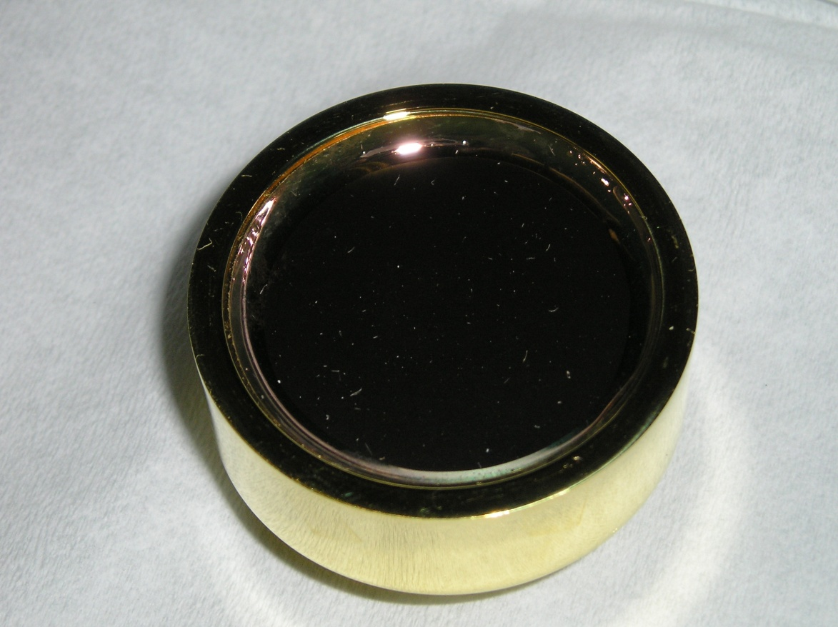
Electron-proton detector
Surface Barrier Detector (SBD)
Four detectors used during run
600mm²
At -25kV

Slide 9
Calibration
Currently running in Bldg 245
Temperature dependence of APDs around 90K
MC benchmarks with various sources and energies
¹³⁷Cs – 662keV
⁵⁷Co – 122 and 136keV
¹³³Ba – 80 and 356keV
²⁴¹Am – 60keV
Electron linearity check

Slide 10
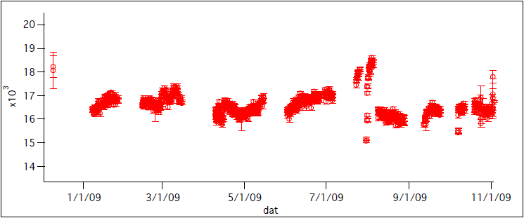
Calibration: Temperature dependence

Slide 11
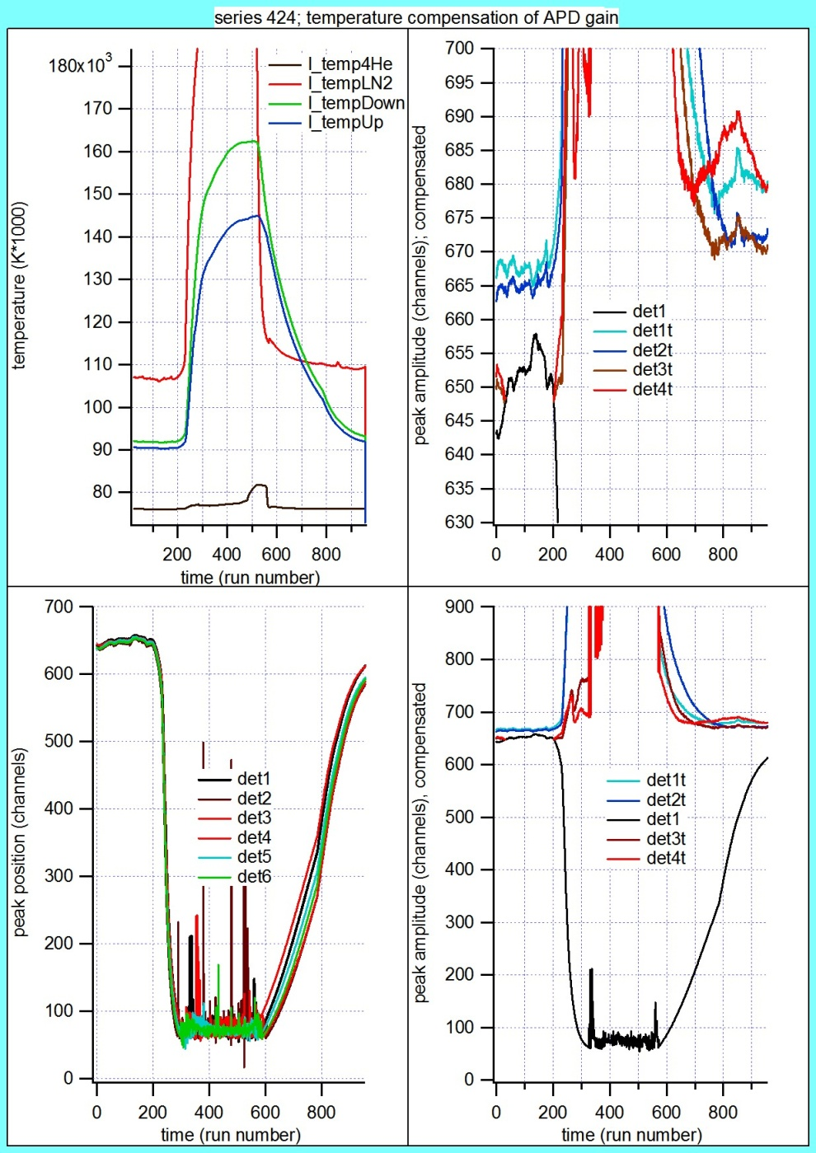
Calibration: Temperature dependence

Slide 12
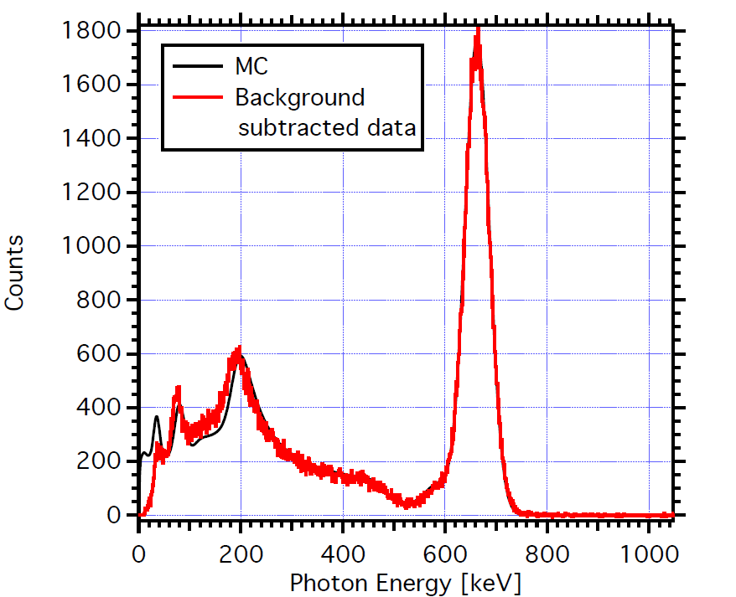
Calibration: ¹³⁷Cs spectrum

Slide 13
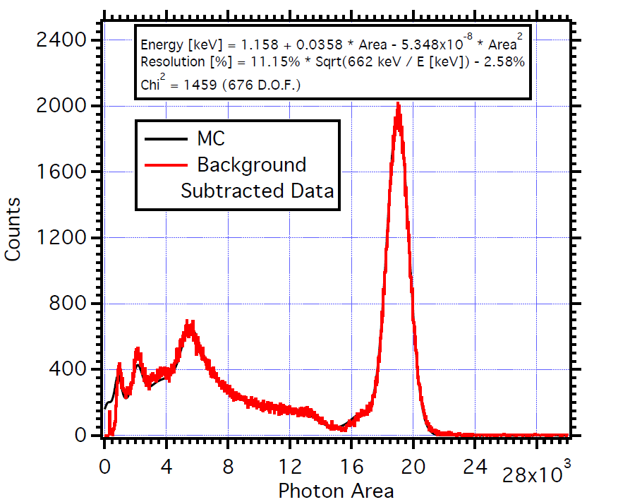
Calibration: ¹³⁷Cs spectrum

Slide 14
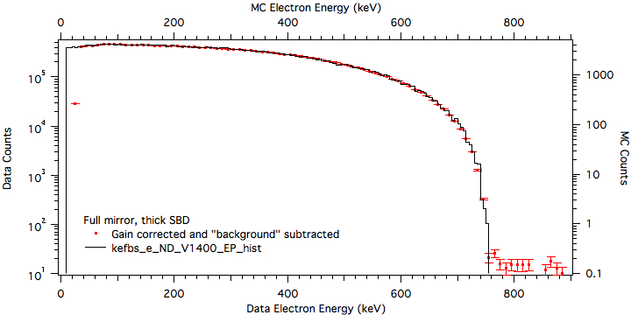
Calibration: Electron linearity

Slide 15
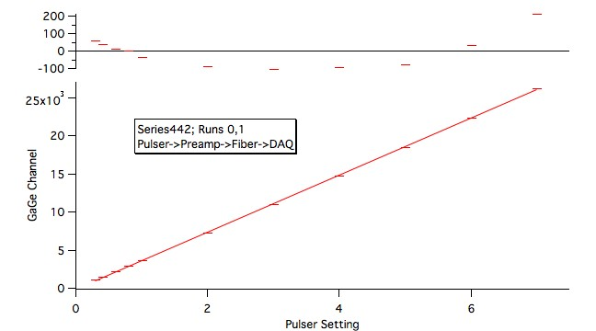
Calibration: Electron linearity

Slide 16
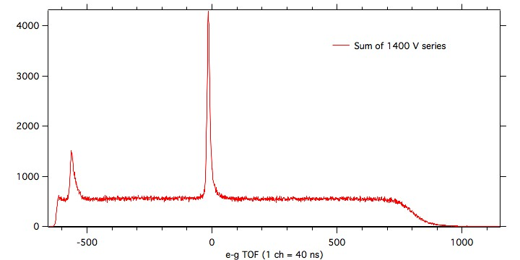
Results: Electron-photon time of flight
Preliminary
Notes:
And finally, some results. Here is a preliminary analysis of the electron-photon time of flight. As you can see, there is a (fairly) uniform distribution of background events and a large coincidence peak. These coincident events, corrected for background, will be used later to determine the branching ratio.

Slide 17
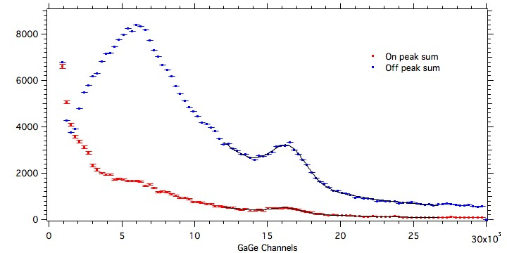
Results: Photon energy spectrum
Preliminary
Notes:
This is the photon energy spectrum (in arbitrary units), for both the coincident and background events, in red and blue respectively. In this plot, the background spectrum here appears larger than the radiative spectrum because of the difference in the size of the on peak and off peak timing windows. Here is the positron annihilation peak that we use for our in situ calibrations.

Slide 18
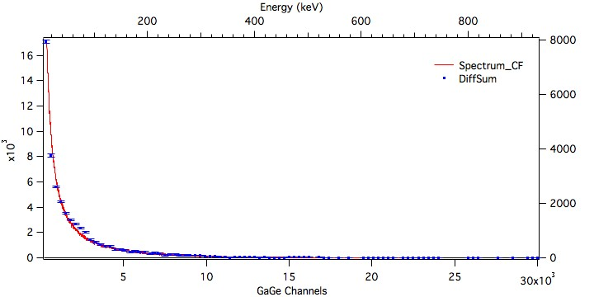
Results: Photon energy spectrum
Preliminary
Notes:
After subtracting the background, scaled to the timing window, we are left with the radiative decay spectrum. Even without proper calibrations, you can see this is in good agreement with the theory (overlaid in red).
Since finishing our data acquisition in early November, we have continued to refine our analysis and are now beginning with calibrations.
In the next talk, Mathew Bales will discuss our efforts to model the experiment with the Monte Carlo simulations.
That concludes my presentation. Are there any questions?

Slide 19
Analysis
 | All voltages | Full Mirror
Run time | 164.4d | 97.8d
Live time | 147.1d | 87.5d
Total triggers | 9.7x10⁷ | 6.8x10⁷
Run data | 6.4Tb | 4.4Tb
Total data | 22Tb
Parameters to extract from waveforms
Energy
Electron
Proton
Photon
Time of Flight
Electron-proton
Electron-photon
Notes:
Now, on to the analysis. The experiment ran for 164 days. In that time, we collected data from 97 million events, totaling 6.4Tb of run time data and 22Tb including calibration runs. From the signals I showed earlier, there are 5 relevant parameters to extract, namely the energy of each particle and the time of flight of the proton and photon. Since the ep signal is read from a pulse shaping amplifier, the electron and proton parameters are rather trivial to calculate. It is more difficult to analyze the photon data because we read directly from charge integrating pre-amps. Over the next few slides, I’ll discuss two of the ways we determine the photon energy and time of flight from the BGO waveforms.

Slide 20
Curve fitting
Fit function
A+Be^{-C(x-t)}(1-e^{-D(x-t)})
A = signal drift (electronics)
B = intensity
C = falling rate (electronics)
D = rising rate (BGO to APD)
t = time
E = energy
Hybrid linear/non-linear regression
Allows measurement of additional parameters
Poor fits with some signals
Notes:
One technique we used is to fit our signals to a model. In this model, the first exponential term (with the C) describes the discharge of the pre-amps. The second exponential (with D) describes how energy is transferred from the BGO to APD. Since this is a non-linear function, it requires the use of an iterative non-linear regression. However, in the interest of speed, we developed an algorithm to calculate B through a linear regression while C and D were treated non-linearly.
One of the nice things about this method, is that it allows us to calculate additional parameters such as the noise and characteristics of the detector settings. Unfortunately, this is a very time consuming algorithm and returns poor fits for some signals.

Slide 21
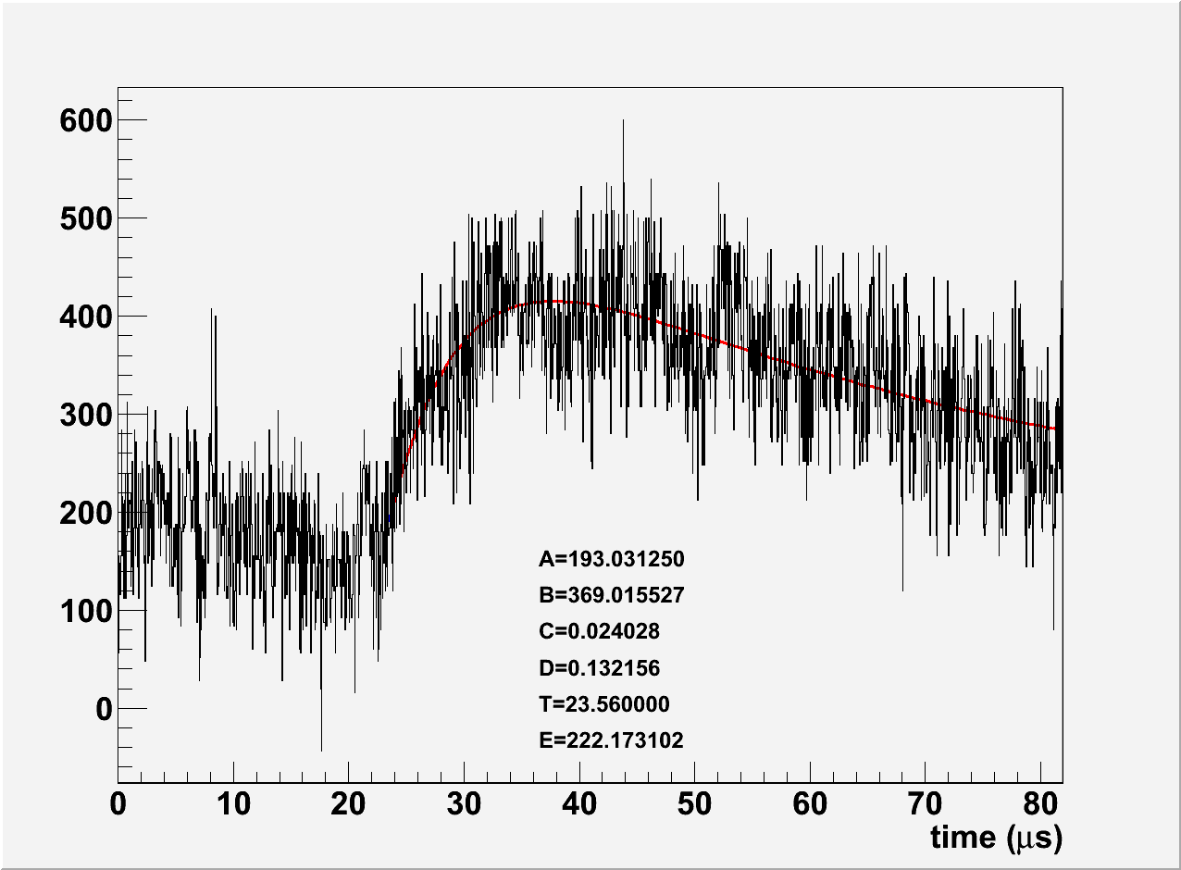
Curve fitting
Notes:
Here are a few examples of our results from curve fitting.
This is a rather typical event. The blue dot is the beginning of the signal and were we start fitting from. As you can see, it does a very good job of picking out these kind of signals, even when the digitizer noise is comparable to the signal.

Slide 22
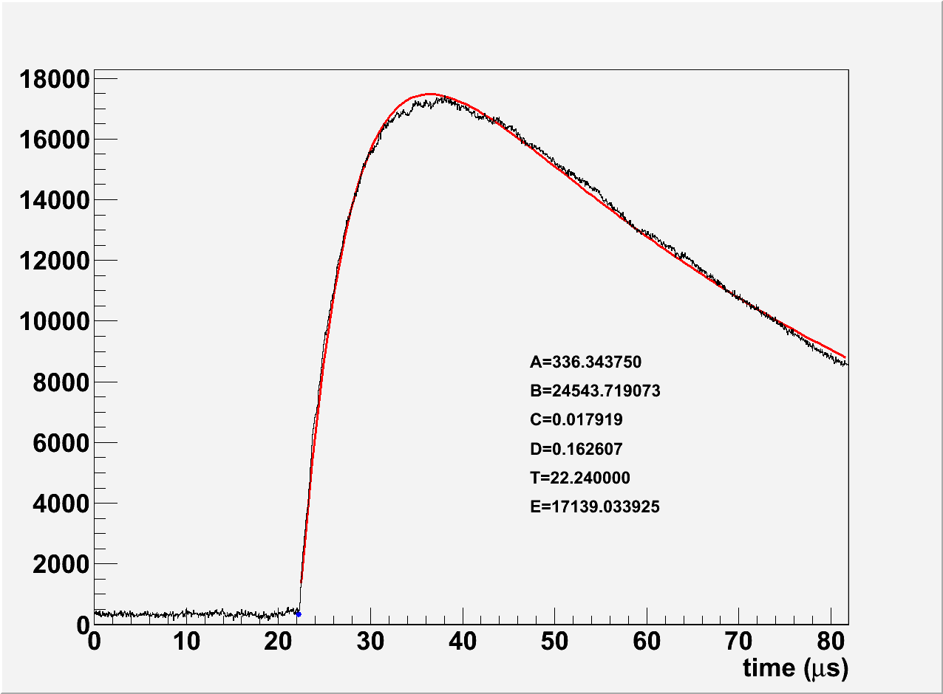
Curve fitting
Notes:
This is a rather high amplitude signal. As you can see, it still does a reasonable job, despite deviating from our model by returning to the baseline more slowly.

Slide 23
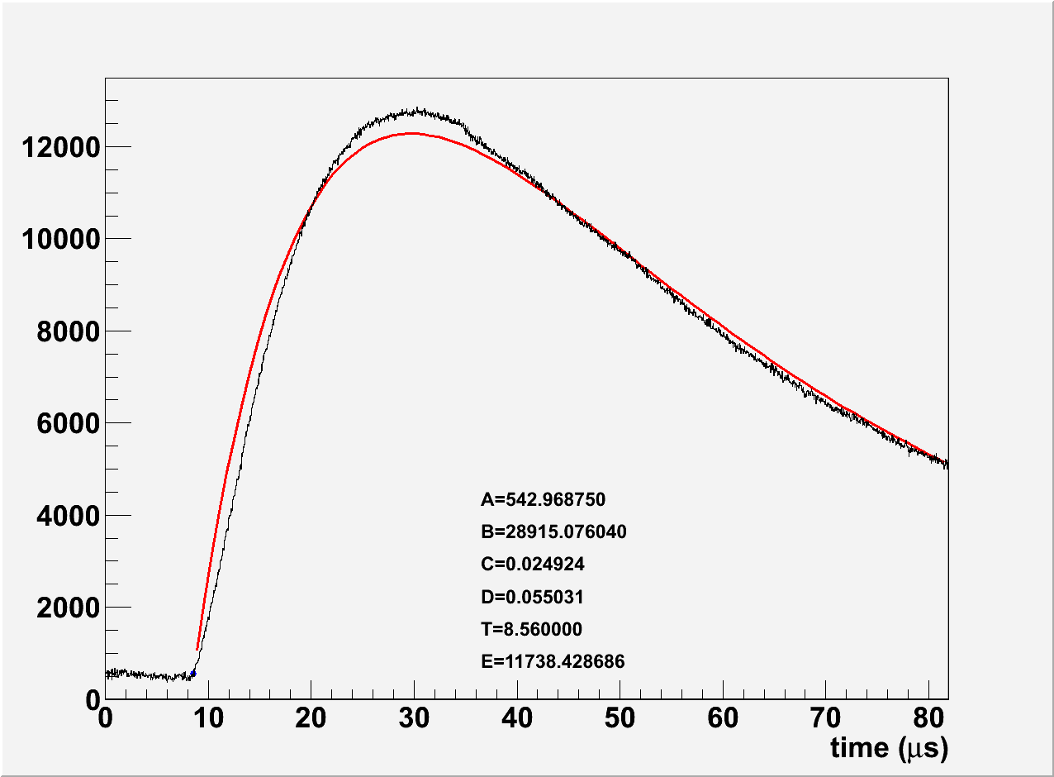
Curve fitting
Notes:
This is one of the bad fits. Through this analysis, we discovered that one particular detector responds unusually slowly.

Slide 24
Smoothing
Adaptation of locally weighted scatterplot smoothing (LOWESS) algorithm
Uniform spacing of points allows the use of a simple transformation matrix
Adjustable smoothing radius R
Tradeoff between timing resolution and noise reduction
Notes:
To address the shortcomings of the curve fitting, we’ve also applied a smoothing algorithm. For this, we adapted a locally weighted scatterplot smoothing, or LOWESS, algorithm. Since the spacing of each point in the signal is uniform, it is unnecessary to calculate a linear regression for each point. Instead, one can calculate a single transformation matrix and do a single pass through the signal, thus improving the performance. It is also easy to adjust the weighting function depending on how smooth you need the signal to be. In this case, a higher smoothing radius will filter out more noise, but at the cost of timing resolution.

Slide 25
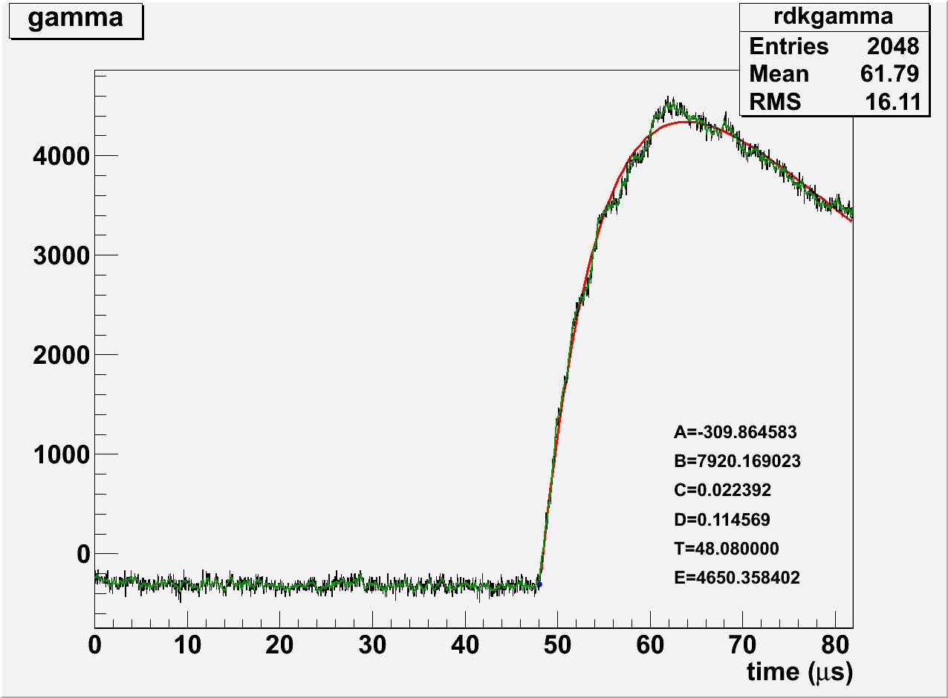
Smoothing
Notes:
Here is a comparison of the results of smoothing (in green) and curve fitting (in red). This plot was produced using a smoothing radius of 4. As you can see, the smoothing more closely follows the signal.

Slide 26
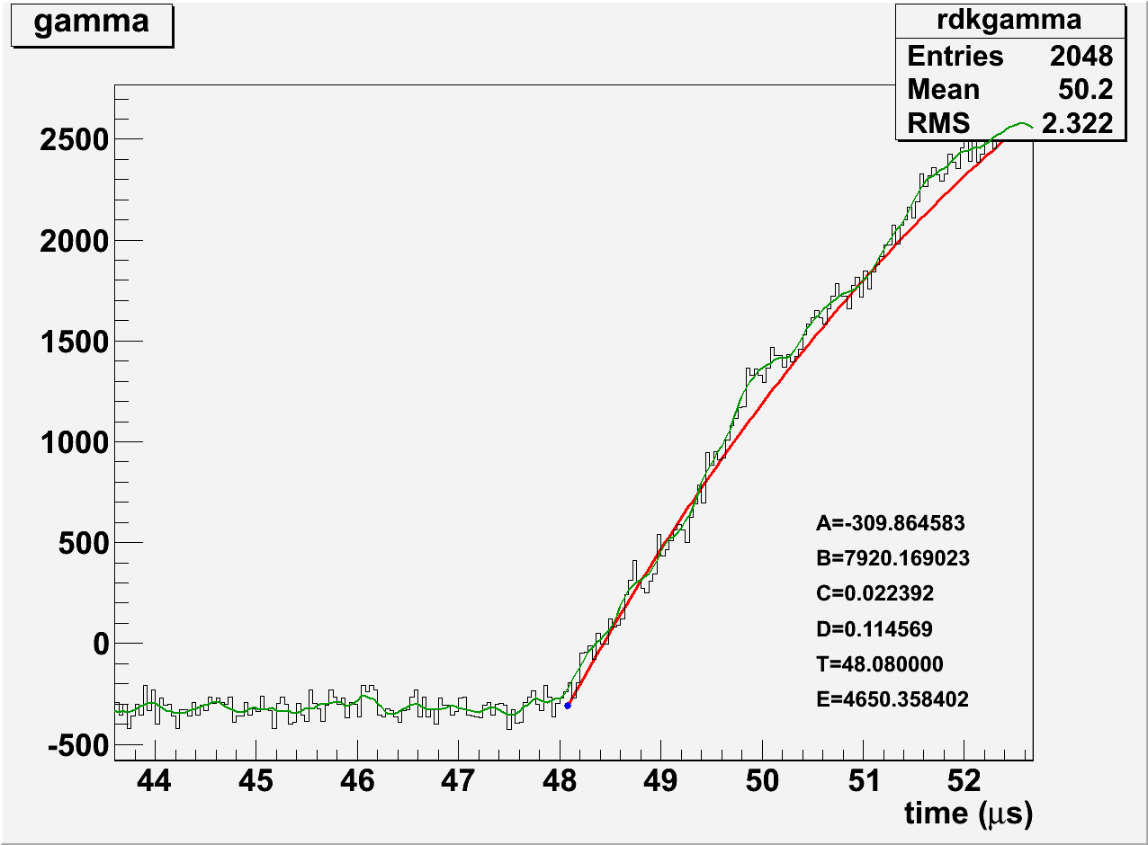
Smoothing
Notes:
If we zoom in, we can see that the smoothing removes most of the digitizer noise. Thus the value of t is far less ambiguous.

Slide 27
Curve fitting
“A” algorithm
Calculate σ² for the regions between 0 and x in 5.12μs steps
If σ_{x+ 5.12μs} is more than 10% greater than σ_{x}
The range from 0 to x is flat
A = avg. signal strength from 0 to x

Slide 28
Curve fitting
“t” algorithm
Signal strength
Weak: max-min<threshold=1400
Strong: max-min>1.5 threshold=2100
Normal: everything else
Trace signal from maximum to the start
Weak: threshold = A
Normal: threshold = A+σ_{flat}
Strong: threshold = A+2σ_{flat}
Trace backwards until the signal drops below threshold for 80ns and no more than 80 of the next 120ns are above threshold

Slide 29
Curve fitting
Fit algorithm
On the region from T to end of signal
Linear regression
f = A+Bz
z = e^{-C(x-T)}(1-e^{-D(x-T)})
A, C and D are fixed

Slide 30
Curve fitting
Fit algorithm
Non-linear regression
f = A+Be^{-C(x-T)}(1-e^{-D(x-T)})
A and B are fixed

Slide 31
Curve fitting
Fit algorithm
Linear and non-linear regressions done simultaneously
Apply the changes of C and D as determined by non-linear regression
Recalculate the regressions
If the change in χ² is greater than 0.1% then repeat
Maximum of 100 repetitions

Slide 32
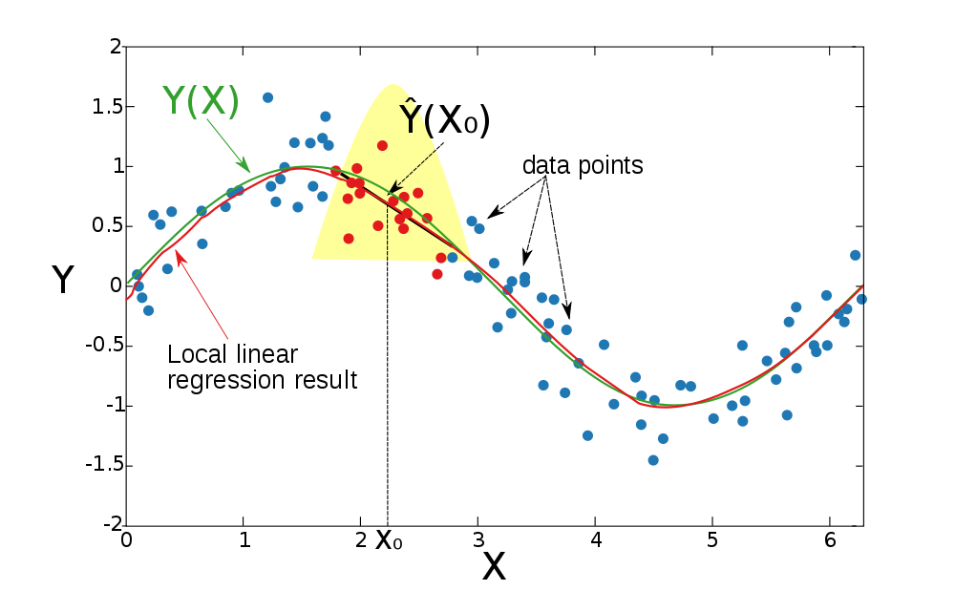
Smoothing

